Slide 1

Learning Group
Projectile Fragmentation of Heavy Ions
Zhiheng Hu
11 Aug, 2026
Notes:
I will briefly introduce the context and the configuration of the new experiment, Previously, we conducted classification and regression studies using an isotropic alpha source, in which the number of tracks ranges from 1 to 4. After successfully determine the track multiplicity and angles for each event, the next step is to perform energy regression to figure out the ability boundary of each approach further. To this end, we will compare 5 approaches: three traditional algorithms, namely Hough, RANSAC, and Hierarchical Cluster, and two ML approaches, namely Standard ResNet and Cross-Attention ResNet.

Slide 2
Outline
1.Where does Projectile Fragmentation come from?
2. What is Projectile Fragmentation?
3. Why we need to use Projectile Fragmentation?
4.The practical use of Projectile Fragment.
Notes:
I will briefly introduce the context and the configuration of the new experiment, Previously, we conducted classification and regression studies using an isotropic alpha source, in which the number of tracks ranges from 1 to 4. After successfully determine the track multiplicity and angles for each event, the next step is to perform energy regression to figure out the ability boundary of each approach further. To this end, we will compare 5 approaches: three traditional algorithms, namely Hough, RANSAC, and Hierarchical Cluster, and two ML approaches, namely Standard ResNet and Cross-Attention ResNet.

Slide 3
Outline
1.Where does Projectile Fragmentation come from?
2. What is Projectile Fragmentation?
3. Why we need to use Projectile Fragmentation?
4.The practical use of Projectile Fragment.
Notes:
I will briefly introduce the context and the configuration of the new experiment, Previously, we conducted classification and regression studies using an isotropic alpha source, in which the number of tracks ranges from 1 to 4. After successfully determine the track multiplicity and angles for each event, the next step is to perform energy regression to figure out the ability boundary of each approach further. To this end, we will compare 5 approaches: three traditional algorithms, namely Hough, RANSAC, and Hierarchical Cluster, and two ML approaches, namely Standard ResNet and Cross-Attention ResNet.

Slide 4
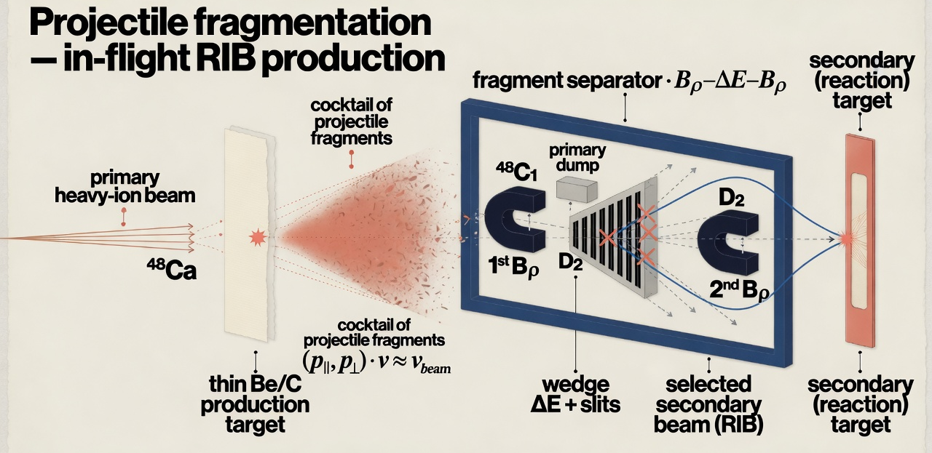
1. Where does Projectile Fragmentation come from?
In principle, any nuclear reaction that produces radioactive nuclei can feed a secondary beam. It only became practical for reaction studies after the discovery of projectile fragmentation in high-energy heavy-ion collisions.
Learning Group
1 / 10
Notes:
I will briefly introduce the context and the configuration of the new experiment, Previously, we conducted classification and regression studies using an isotropic alpha source, in which the number of tracks ranges from 1 to 4. After successfully determine the track multiplicity and angles for each event, the next step is to perform energy regression to figure out the ability boundary of each approach further. To this end, we will compare 5 approaches: three traditional algorithms, namely Hough, RANSAC, and Hierarchical Cluster, and two ML approaches, namely Standard ResNet and Cross-Attention ResNet.

Slide 5
1. Where does Projectile Fragmentation come from?
It originates in high-energy heavy-ion collisions — first seen at the Bevalac (LBL) in 1975.
Historical origin
Physical process
Greiner et al. (Phys. Rev. Lett. 35, 152) measured ¹²C & ¹⁶O at 2.1 AGeV on Be–Pb targets at the Bevalac.
Heckman/Greiner group established forward fragmentation as a distinct reaction channel.
Late 1970s: method pioneered for in-flight rare-isotope beams.
A relativistic heavy-ion projectile grazes a thin light target (Be/C).
Peripheral collision abrades nucleons; the excited remnant ablates and de-excites into fragments.
Fragments keep nearly beam velocity in a narrow forward cone.
Learning Group
2 / 10

